Slide 2
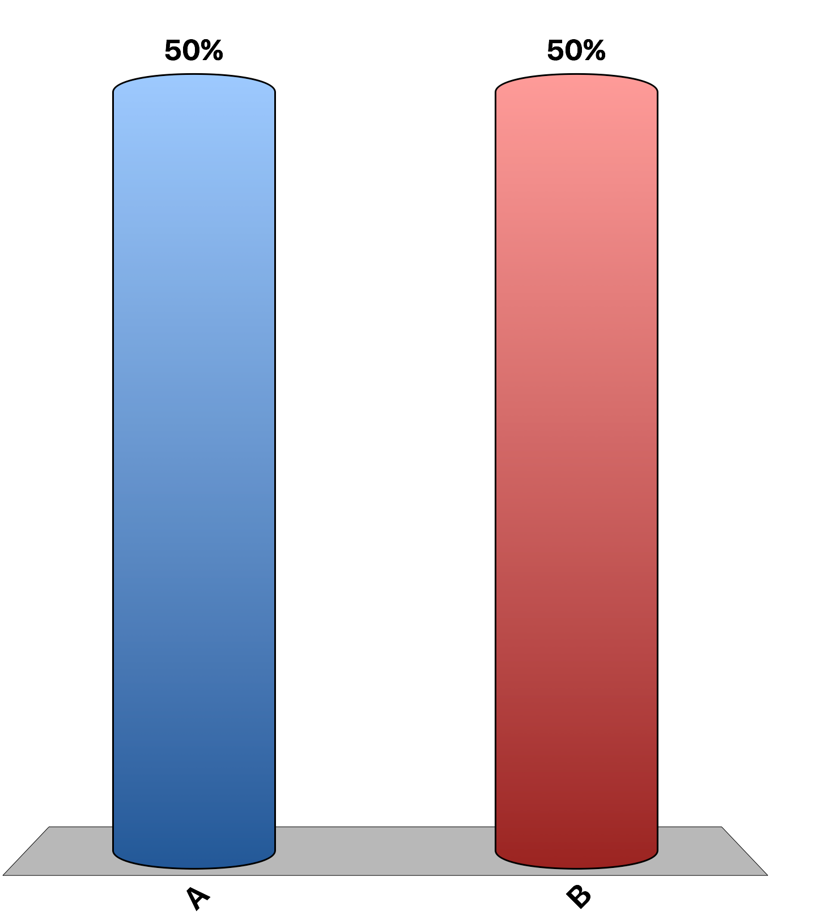
The overall burden of the federal income tax is progressive.
True
False

Slide 3
The deadweight loss of a tax is the decrease in purchasing power of the taxpayer’s income.
True
False

Slide 4
The costs of taxes to taxpayers include the tax payment itself, the deadweight losses, and the administrative burdens.
True
False

Slide 5
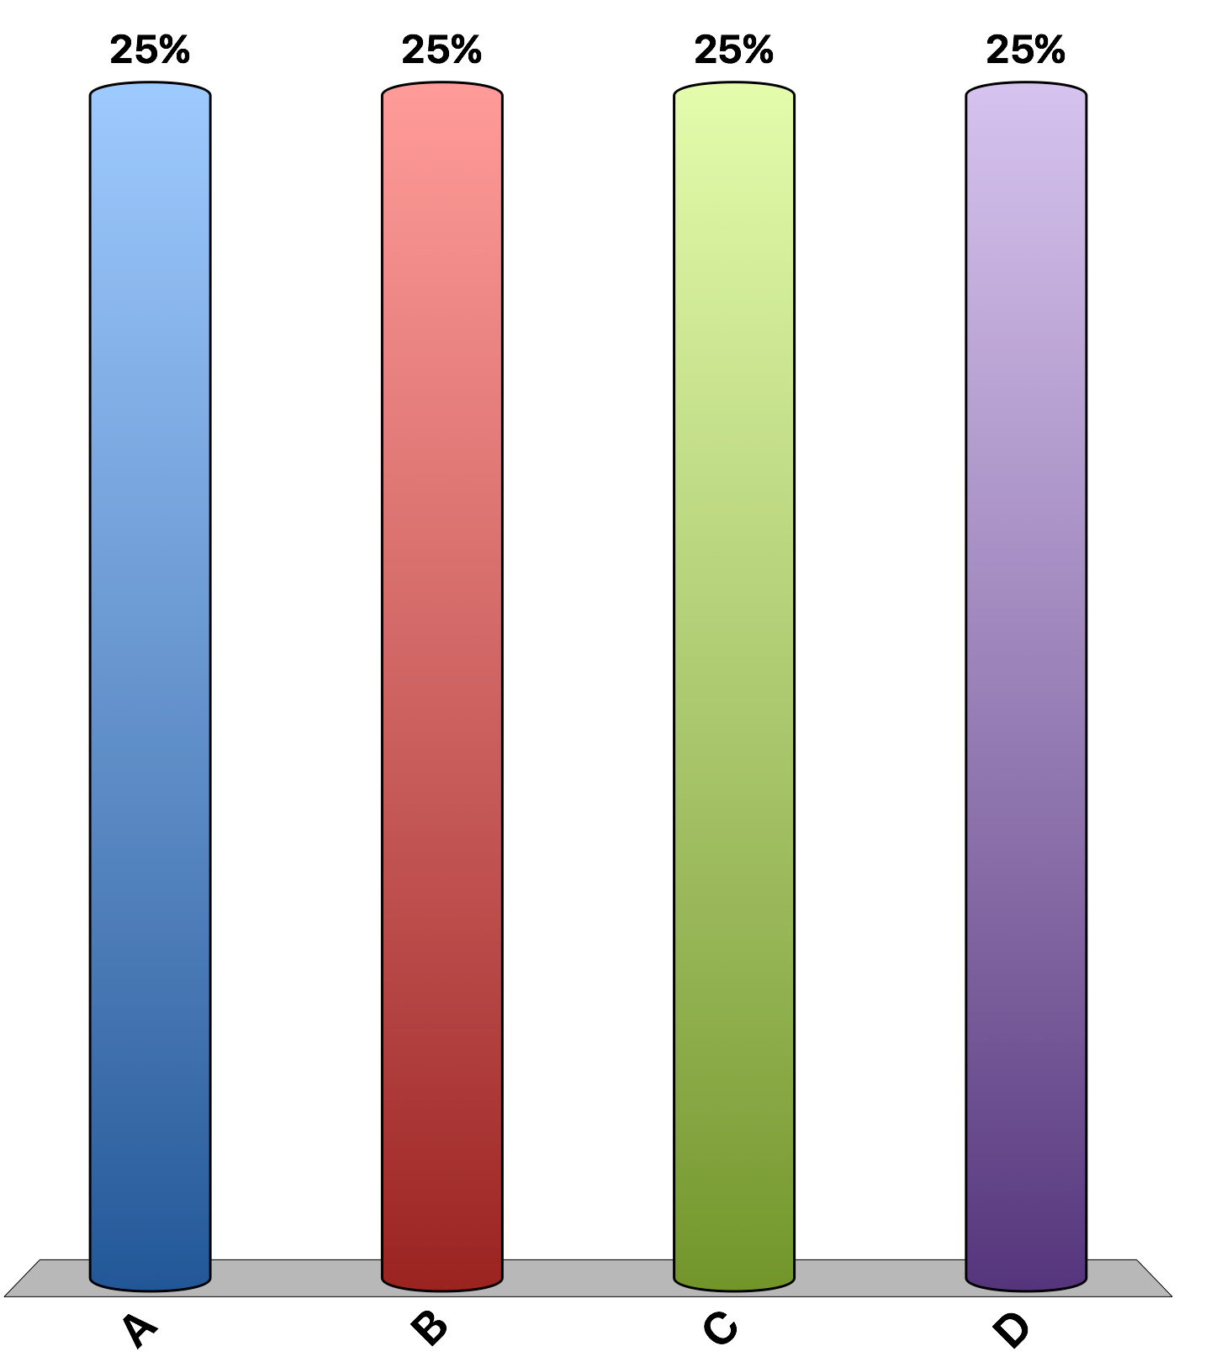
A tax on expensive fur coats is vertically equitable because most buyers of furs are wealthy.’ This statement is:
correct because only buyers of fur coats will be affected by the tax.
correct because only sellers of fur coats will be affected by the tax.
incorrect because only buyers of fur coats will be affected by the tax.
incorrect because the burden of the tax will fall more on those who make and sell furs than on those who buy them.

Slide 6
The largest source of revenue for the federal government is the
corporate income tax.
sales tax.
social insurance tax.
personal income tax.

Slide 7
The two largest sources of tax revenue for state governments are
sales taxes and personal income taxes.
personal income taxes and corporate income taxes.
property taxes and personal income taxes.
property taxes and sales taxes.

Slide 8
Increasing the corporate income tax rate is a good way to raise government revenue because it affects only the corporations and not the people.’ This statement is likely:
false, because corporations will decrease investments, wages will fall and prices for the goods produced will rise.
true, because corporations are not people.
true, because corporations will increase investments to avoid paying the higher tax.
false, because corporations are people.

Slide 9
Suppose that the government taxes 10% of the first $20,000 of income and 20% of all income above $20,000. A person who earns $50,000 pays a total tax of
$15,000.
$8,000.
$5,000.
$3,000.

Slide 10
Suppose that the government taxes 10% of the first $30,000 of income and 20% of all income above $30,000. A person who earns $80,000 pays a marginal tax rate of
10% and an average tax rate of 6.15%.
10% and an average tax rate of 16.25%.
20% and an average tax rate of 6.15%.
20% and an average tax rate of 16.25%.

Slide 11
Suppose the government creates the following tax structure: The average tax rate is P for an income of $20,000, Q for an income of $40,000, and R for an income of $60,000. P, Q, and R are respectively:
30%, 25%, 20%
20%, 20%, 20%
25%, 30%, 35%
6.25%, 16.25%, 26.25%

Slide 12
Suppose the government creates the following tax structure: The marginal tax rate is X for the first $20,000, Y for the next $20,000, and Z for income above $40,000. X, Y, and Z are respectively:
10%, 20%, 30% and this is a progressive tax system
30%, 20%, 10% and this is a regressive tax system
6%, 10%, 12% and this is a progressive tax system
12%, 10%, 6% and this is a regressive tax system

Slide 13
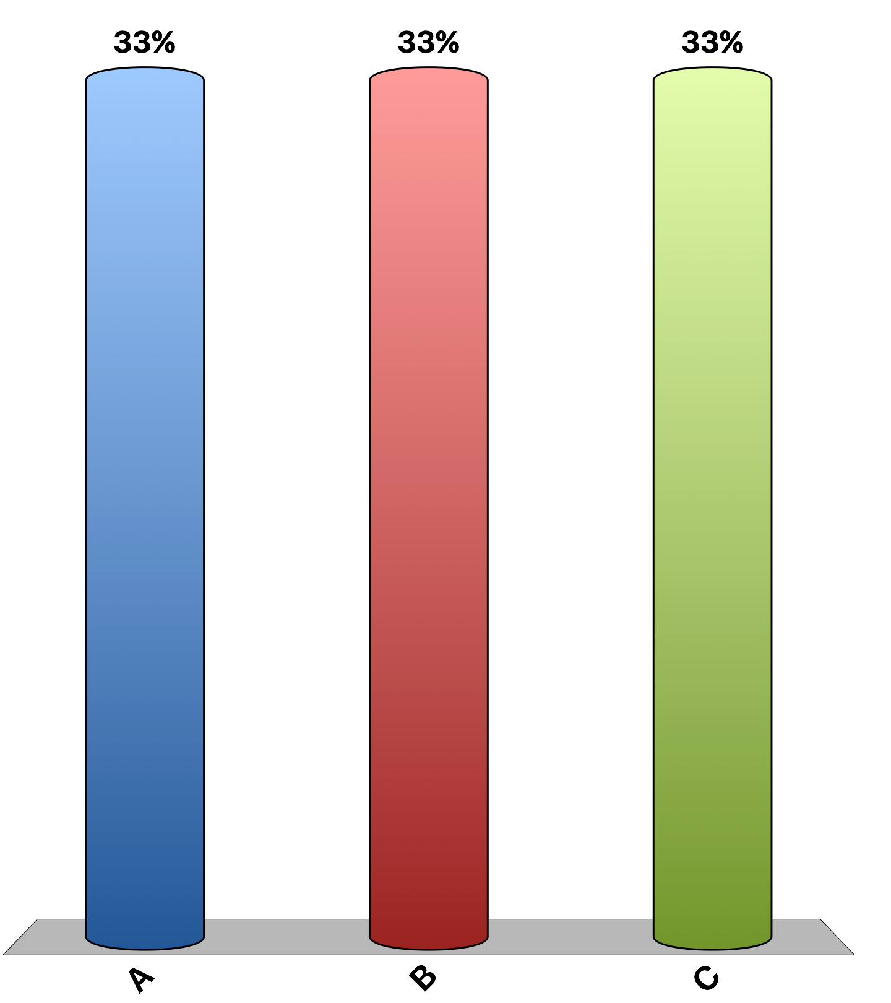
Your parents get a tax deduction for each child starting in the year he/she is born regardless of the child’s birth month. Some people believe that parents time their children to maximize their tax deductions. Let’s see if that is true for our class. What month were you born?
November or December
January or February
Some other month

Slide 14
“The rich don't pay their fair share of taxes.”
agree
disagree
uncertain
Notes:
Refer to Table 5, The Burden of Federal Taxes, to start a class discussion on this topic.

